Slide 1
Module 12: Using Third Party Plugins
SER 423

Slide 2
Overview
Last time we looked at expo and why we use it
Expo can be a very helpful tool in build an app, but it can also limit our choices
This time we are going to look at a few plugins that you can use to add functionality that is either not available in expo/react or just makes it easier
Not all of these are incompatible with expo, but it is something to double check before trying to add it to your project
Another thing to note: working with native code really requires some work using Android Studio or XCode as appropriate
You will want to edit at least the native portion of your app in those, rather than your regular editor
  See the book for detailed instructions on how to set your project up in them
A thing to keep in mind - if you’re not editing the native code, are you sure you needed a pure react native app?

Slide 3
NativeBase

Slide 4
Using NativeBase
NativeBase is a simple plugin for creating cross platform components
We’ll start with this one since it is simple to setup and doesn’t force native editing
NativeBase is expo friendly - we’ll look at how to set it up either way
Once the project is made, you can cd into the project directory and install the plugin
  Pure react: npm install native-base --save or yarn add native-base
  Expo: npm install native-base @expo/vector-icons --save or yarn add native-base @expo vector-icons
The difference between the two is the dependencies
If you use a pure react project, you still need to install the dependencies with react-native link
  Remember this breaks an expo project!

Slide 5
A Quick Aside About react-native link
A question you might have asked is why does using this command break an expo project?
If you look around, you usually find an answer along the lines of “react native has many core feature bugs that they just don’t fix” and that this is just one of those bugs
Using the link command can break a lot more than just expo apps
A reasonable follow up question then is why don’t they fix these bugs?
Who knows?
However, in the case of link (and unlink) it might be because the most recent version of the react CLI included a breaking change that removed both of these commands
This was done only a few weeks before this module was designed
It is included because the book talks about it, and because the replacement (auto linking) is not yet well understood by the community
But this is also why we do not spend a lot of time on this problem

Slide 6
Continuing with NativeBase
NativeBase contains a couple of cool features
  FABs - Floating Action Buttons for primary actions
  Spinners - For easily showing loading
  Toasts - Small notifications that pop up on the bottom of your screen
A Fab is a regular element that can be added to a View
It takes a position as a string which will determine where the icon will appear
A spinner is also an element that can be easily added to any View
You likely want to use a boolean to determine whether or not to show the spinner
Toasts are usually used for onPress actions
You call Toast.show and pass it the text to display as well as the text for the button to close it
Quick note: If you’re using expo, NativeBase recommends loading the fonts asynchronously during componentWillMount

Slide 7
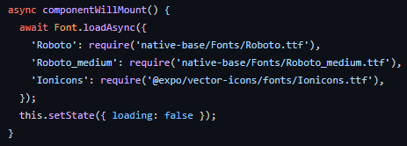
Font Loading

Slide 8
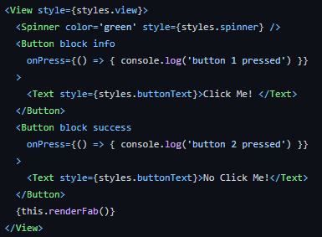
Example Spinner

Slide 9
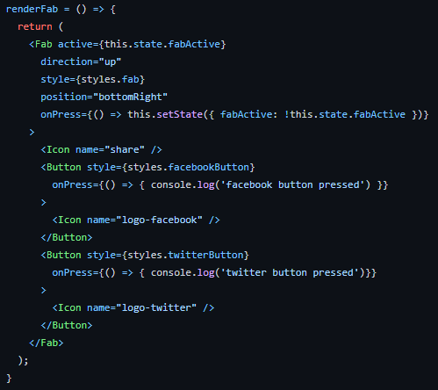
Example FAB

Slide 10
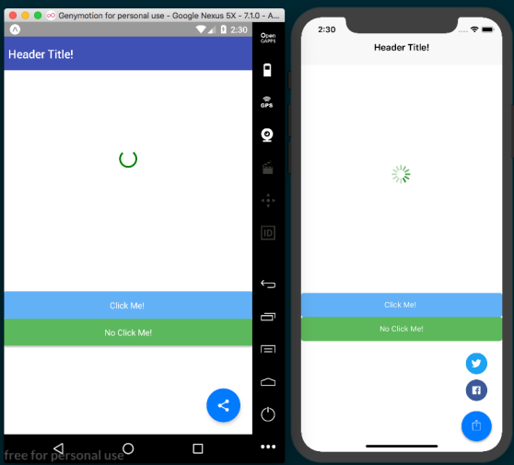
What All That Looks Like

Slide 11
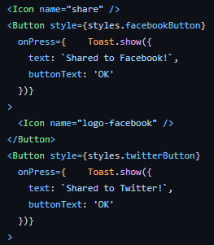
Toast Example

Slide 12
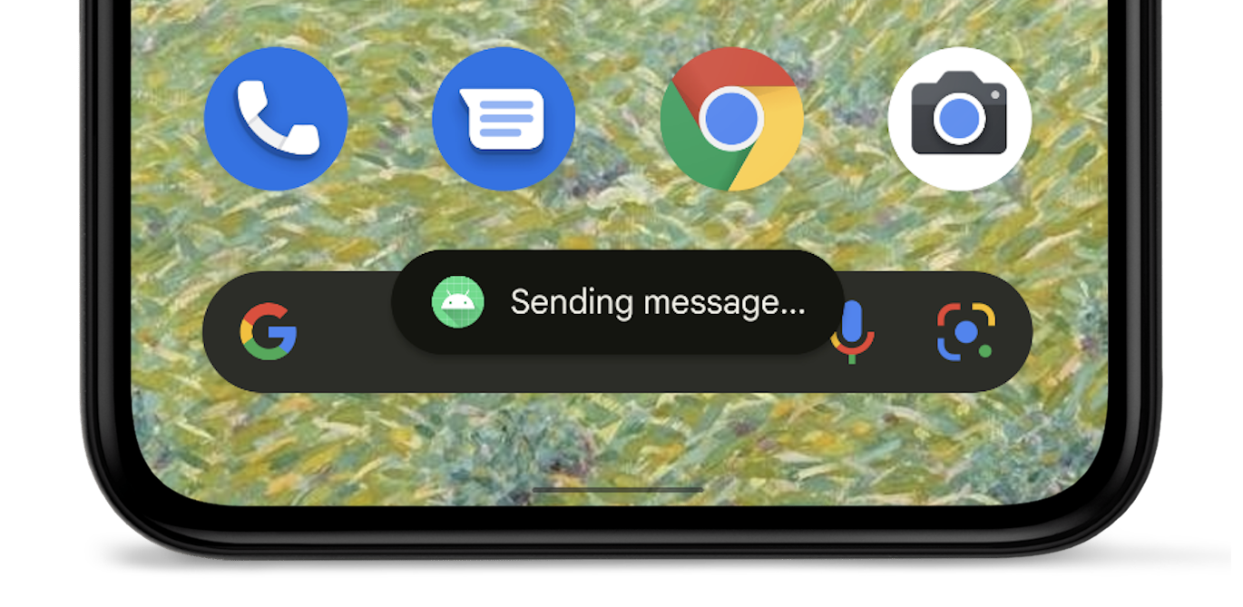
What a Toast Looks Like

Slide 13
SpinKit

Slide 14
Using SpinKit
SpinKit is another example of a plugin that you can add to your react app
It is likely inevitable that your app will at some point be waiting for an async process to complete
Your app will not hang because it is an async process, but if nothing is moving the User might think it has
SpinKit offers several loading indicators you might want to consider using
SpinKit requires the use of react-native link so either create a pure react project or eject your app from expo before adding this plugin
Add it to the project with:
  npm install react-native-spinkit@latest --save or yarn add react-native-spinkit@latest
Then do react-native link

Slide 15
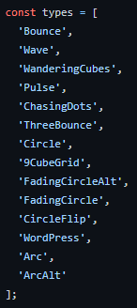
Types of Spinners

Slide 16
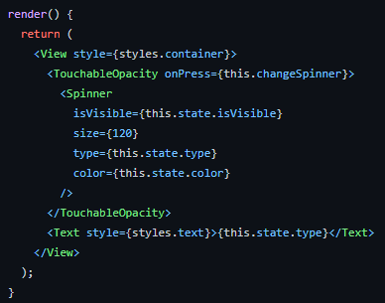
Using a Spinner

Slide 17
End of Using Third Party Plugins
That’s it for Module 12!

